Slide 1
Wifi Positioning Analysis
Grant Wisner

Slide 2
Summary of Requirement
To investigate the feasibility of using "wifi fingerprinting" to determine a person's location in indoor spaces using the signals from wifi hotspots
To evaluate multiple machine learning models to see which produces the best result, enabling us to make a recommendation to the client.

Slide 3
Summary of Data
Data comes from the UJIIndoorLoc database, which covers three buildings with 4 or more floors and almost 110.000m2
Created by 20 different users and 25 Android devices
The database consists of 19937 training/reference records and 1111 validation/test records
Variables include:
Wifi Signals – 520 data points ranging from 0 to -104 (100 = no-signal)
Longitude and longitude in real values
Floor – value of building floor from 0 to 4
Building ID – values 0 to 2 for three different buildings
Space ID – number to identify whether the space is a office, corridor, or classroom
Relative Position ID – number that gives relative position (inside or outside of room)
User ID – Identifies the user who took the measurement
Phone ID – Identifies the devise used for the measurement
Timestamp – UNIX time when the measurement was taken

Slide 4
Methodology
Used machine learning to predict the “Building and Floor”
Rationale – If a person needed to go to another building, but was currently inside, the phone app would use wifi fingerprinting to give directions on the best way to the next building based on the floor and building the user was currently in
Data tested – Random sample of 5000 observations across all buildings
Algorithms tested – C5.0, Random Forest, and KNN
Used machine learning to predict “Floor, Relative Position, Space id”
Rationale – If the building is not important to the user, this would allow the phone app to provide directions / location inside a particular building
Data tested – All observations for Building 0
Algorithms tested -- C5.0, Random Forest, and KNN

Slide 5
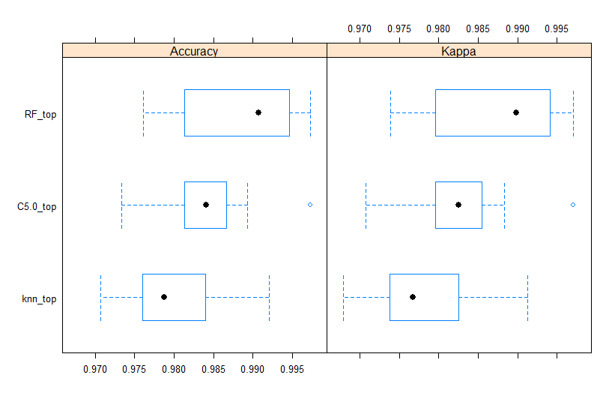
“Building and Floor” -- Model Comparison
Top Performing model: Random Forest where data were “out of the box” and centered and scaled
Performance Metrics
Accuracy – .988
Kappa -- .987

Slide 6
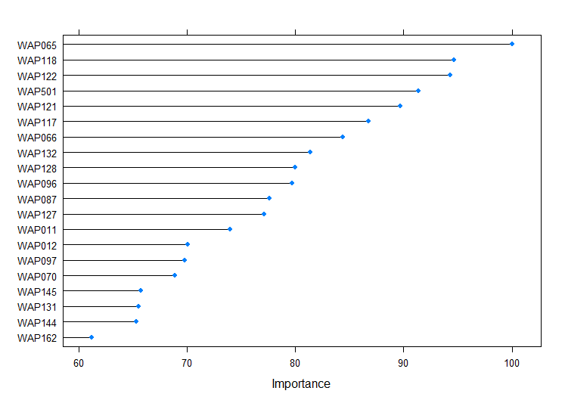
“Building and Floor” -- Top Model Variable Importance
WAP065 had the most significant impact on the overall algorithm performance
Potential reasons could be that this WAP is more centrally located, which would mean its signal would have been captured more often

Slide 7
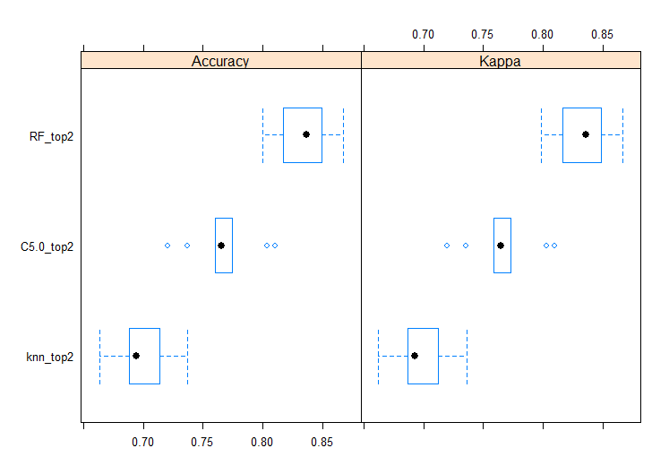
“Floor, Relative Position, Space id” -- Model Comparison
Top Performing model: Random Forest where data were “out of the box” and centered and scaled
Performance Metrics
Accuracy – .834
Kappa -- .834

Slide 8
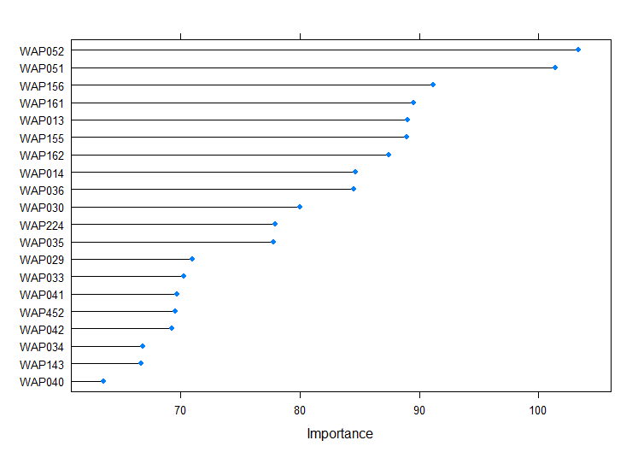
“Floor, Relative Position, Space id” -- Top Model Variable Importance
WAP051 & WAP052 had the most significant impact on the overall algorithm performance
Potential reasons could be that these WAPs are more centrally located in Building 0, which would mean its signal would have been captured more often

Slide 9
Recommendations on Improving Data
More data, more data, more data
Each square meter of each building should be recorded in the dataset by at least three separate phones to ensure proper and accurate readings for all building locations
Integration with other sensor such as camera
Changing environment can change signal strength (i.e. adding a couch or shelving units)
Add Basic Service Set IDentifier (BSSID) to the dataset
Received Signal Strength Indication (RSSI) and Basic Service Set Identifier (BSSID) together solve the problem of position recognition owing to the similar signal strength

Slide 10
Conclusion / Recommendations
Use Random Forest machine learning models to predict user location using wifi fingerprinting
Models can be created / used to provide building to building location or just location inside a particular building
Create phone application using created random forest model and sell to our customer

